Slide 1
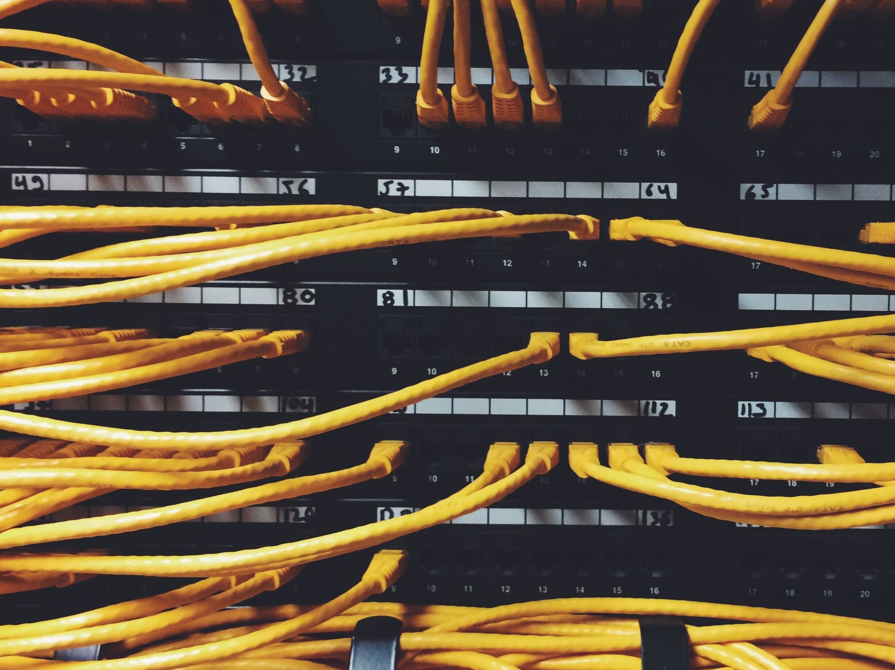

PROJECT WHIPTAIL
Secured IT/OT Integration
MAY
2021

Slide 2
AGENDA
01
Introduction
02
Schedule
03
Original Network Design
04
Penetration Test
05
Risk Assessment
06
Countermeasures
07
Honeypot
08
Improved Network Design
09
Questions

Slide 3



INTRODUCTION
Michael Klym
Network Design
Installation and Configuration
Security Appliances
Gary Khodayari
Risk Assessment
Penetration Test
Mink Jo
Schedule
Countermeasures

Slide 4

INTRODUCTION
Scope
Create an IACS network demonstrating vulnerabilities
Conduct risk assessments following ISA/IEC 62443 guidelines
- Identify assets
- Prioritize countermeasures based on Security Level Targets
Upgrade network and add security appliances
- Firewalls
- SIEM system
- Honeypot
Create the final technical report

Slide 5
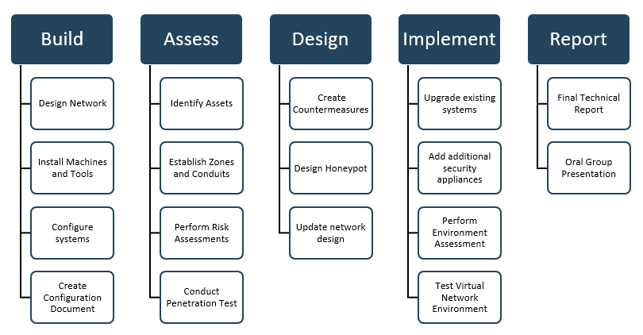
SCHEDULE
WBS (WORK BREAKDOWN STRUCTURE)

Slide 6
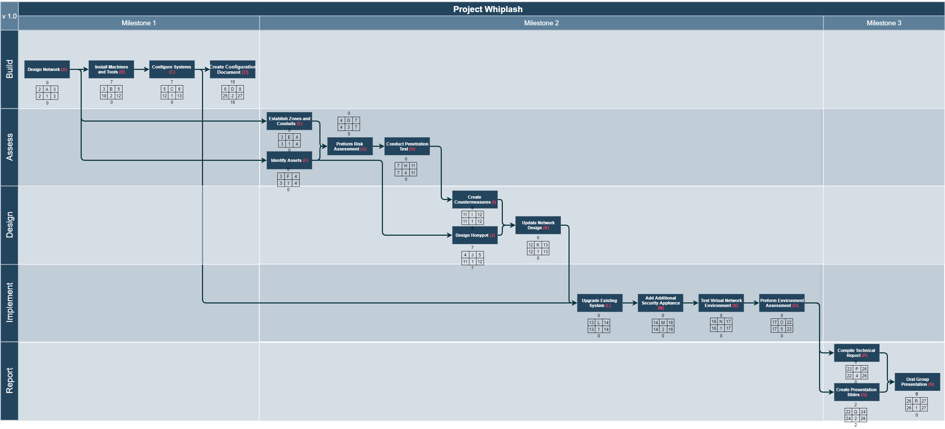
PROJECT SCHEDULE NETWORK DIAGRAM

Slide 7
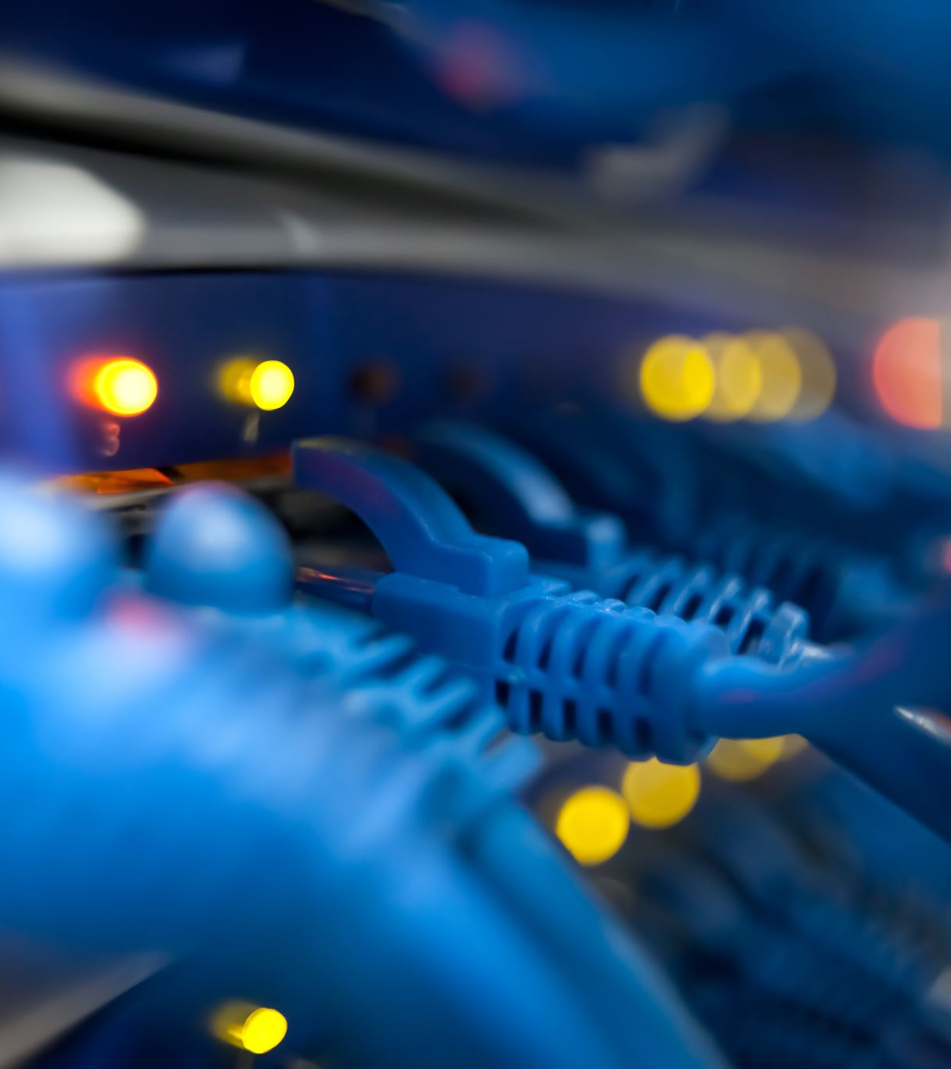
ORIGINAL NETWORK DESIGN
Requirements
Simulate ICS Environment
Fully Virtualized
Low System Requirements

Slide 8
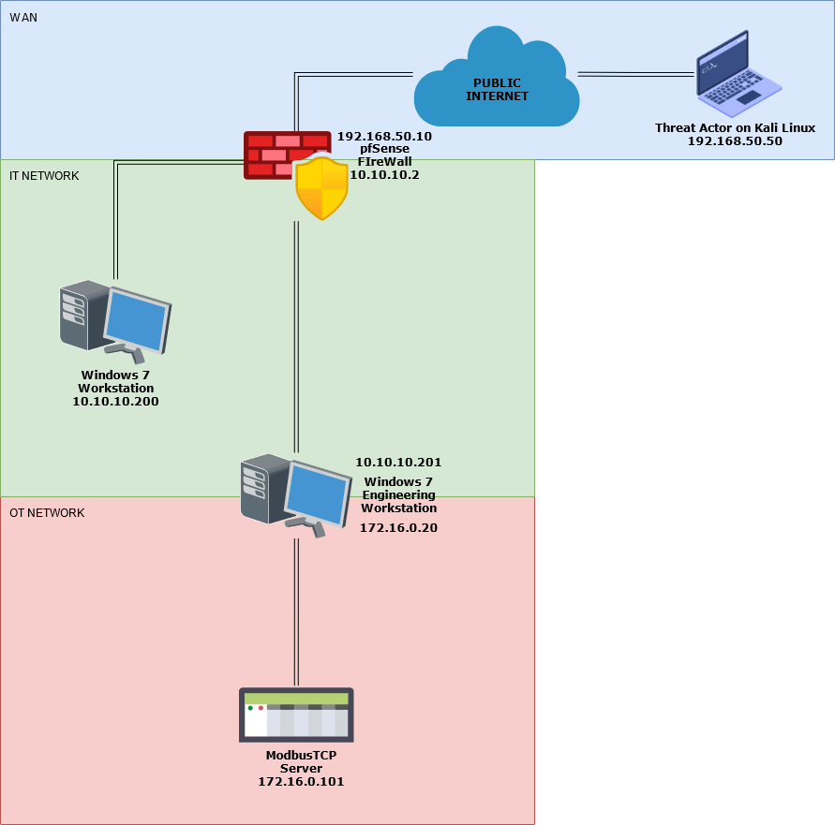
ORIGINAL NETWORK DESIGN
Simplification
Inspired By Pascal Ackerman’s ICS Virtual Test Network (Industrial Cybersecurity)
Remove Redundant Equipment
Retain Core Zones
Reduce Hardware Requirements

Slide 9
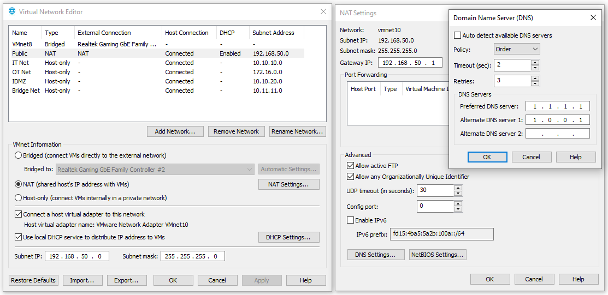
ORIGINAL NETWORK DESIGN
VMware Networking
Virtual Network Editor
Create Zone Networks
Assign Subnets
Static IPv4 Addressing
Public Network NAT Configuration
VMware acts as Default Gateway
IT & OT Networks
Host-only
No Connected Host Virtual Adapter

Slide 10
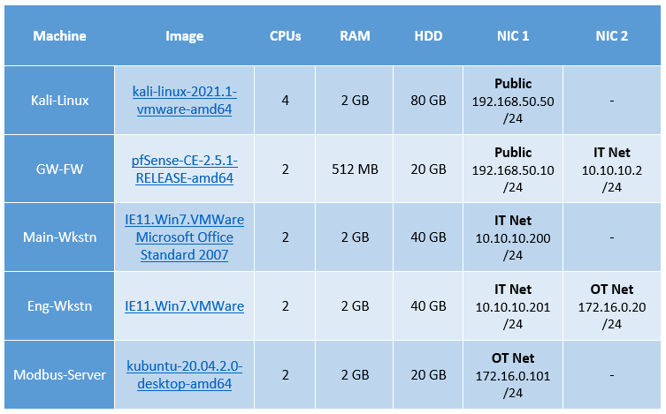
ORIGINAL NETWORK DESIGN
Installing Machines
Publicly Available Images
Pre-built Where Possible
Allocate Resources Efficiently
Host Requirements
4 CPU Cores
8.5 GB RAM (plus overhead)
~100 GB Storage (table shows maximums)

Slide 11

PENETRATION TEST
Testing the limits of our design

Slide 12
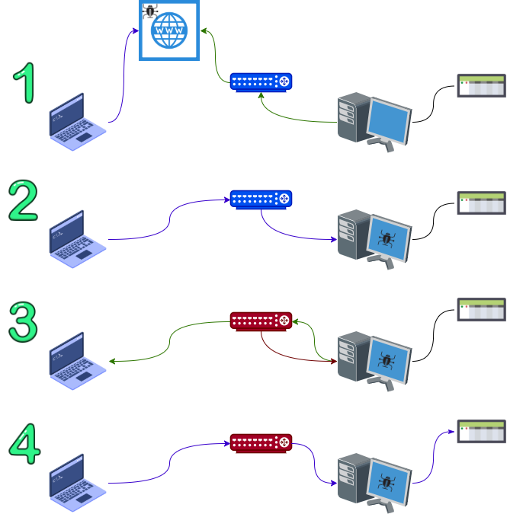
SUMMARY
We sets up a website carrying the payload
Victim downloaded and executed the payload
We tunneled HTTPS traffic through the victim's computer to access the firewall/router configuration and enabled SSH and RDP port forwarding
We used RDP connection to modify PLC program

Slide 13
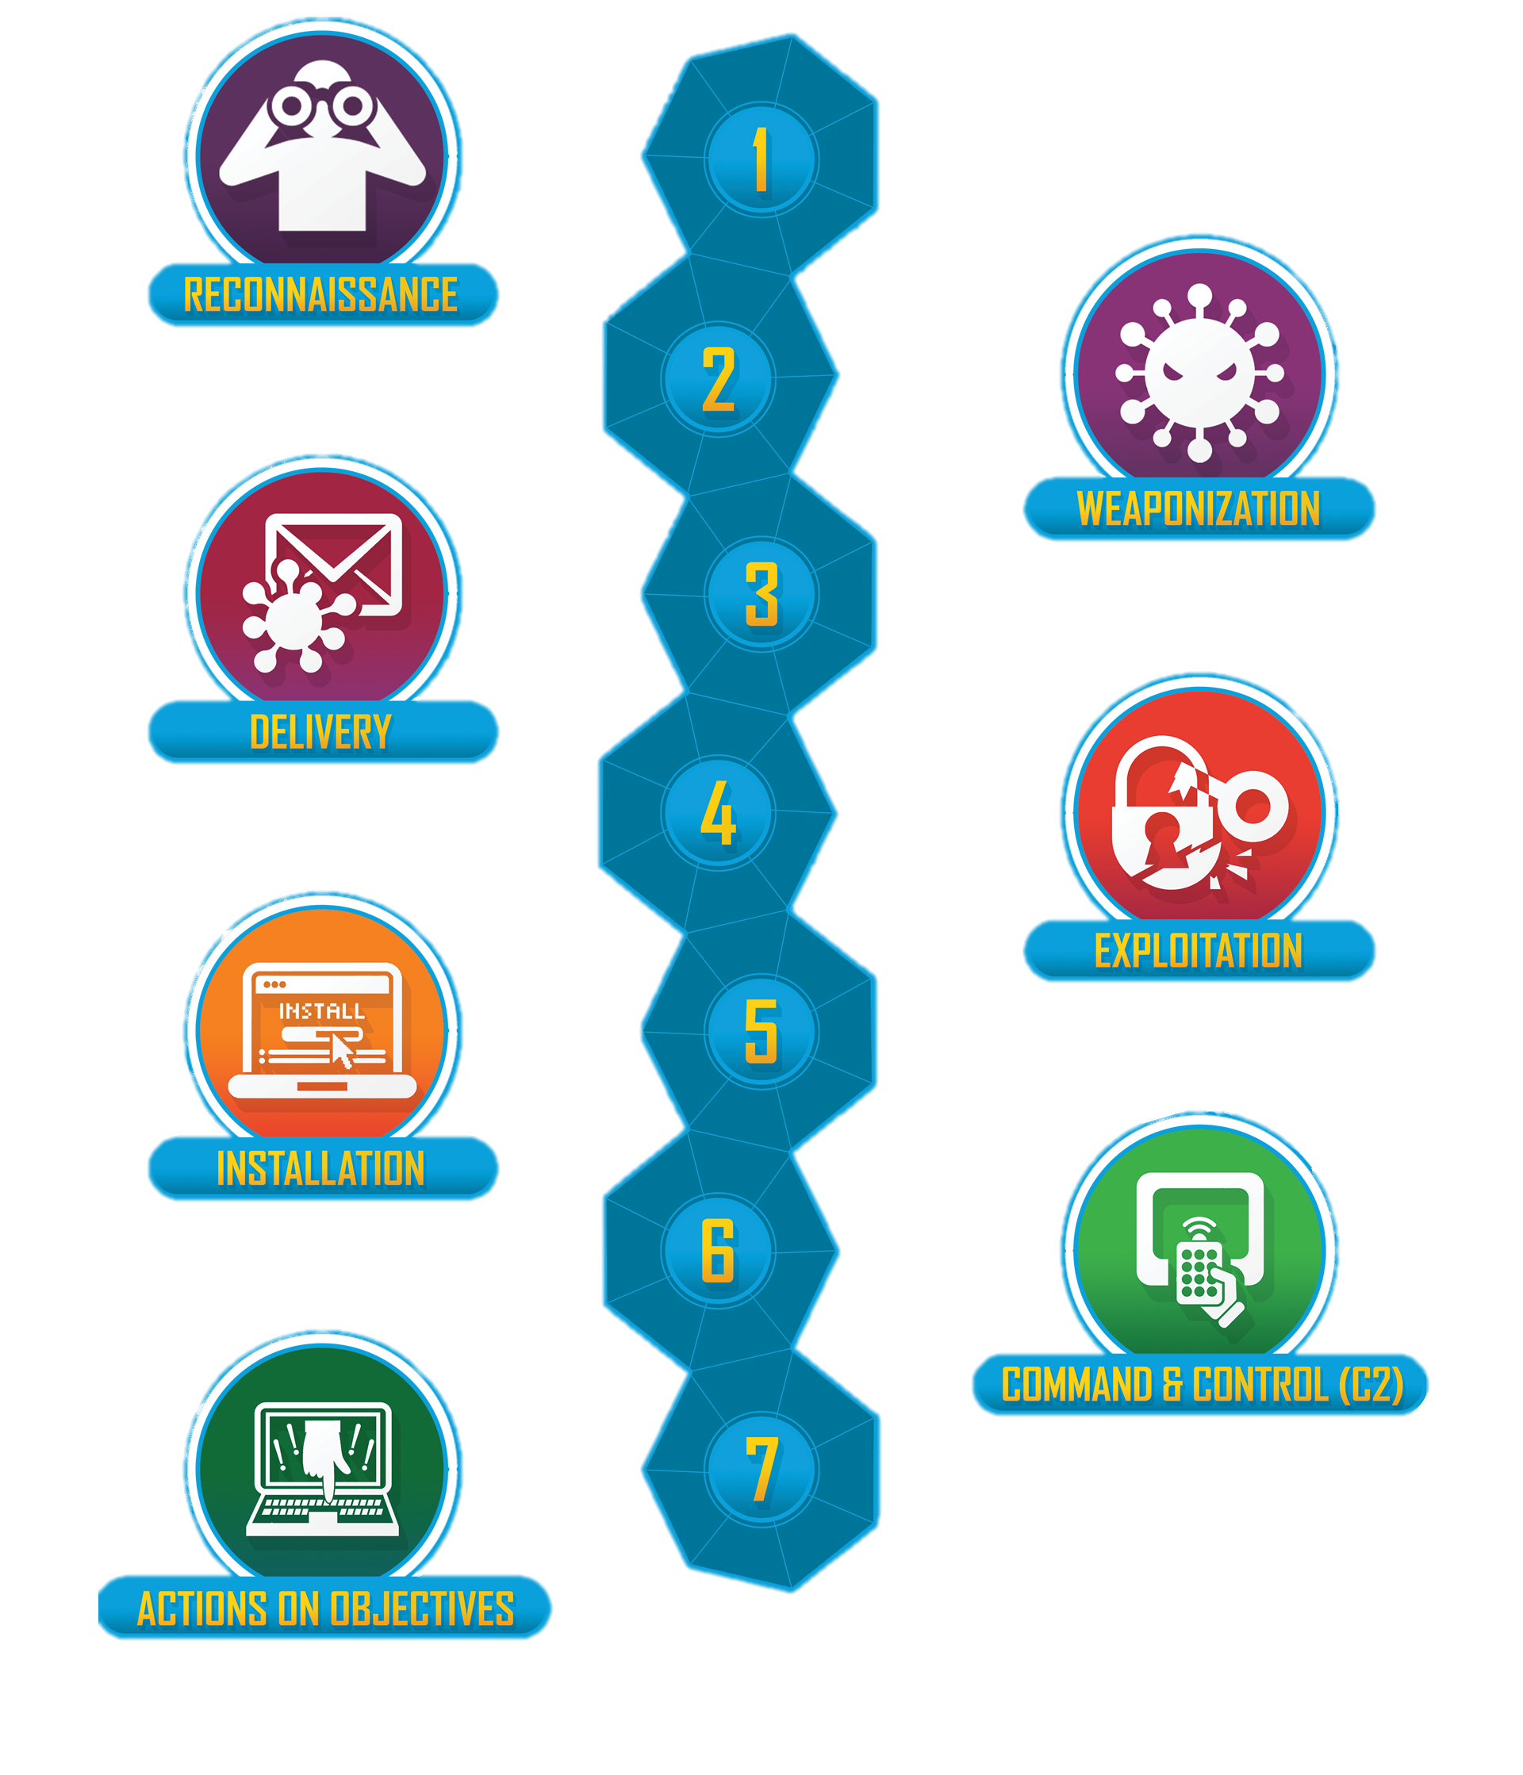
LOCKHEED MARTIN CYBER KILL CHAIN
Developed By Lockheed Martin
A Defense Model For Identification And Prevention Of Cyber Intrusions Activity.

Slide 14

RECONNAISSANCE, WEAPONIZATION & DELIVERY
Humans Can Be An Organization’s Strongest Suit Or The Weakest Link
Social Engineering is the most common initiation for cyber attacks
Social platforms like LinkedIn make it easy to research people and companies
Choose a payload based on the access you have and the tools you need
There are many exploitation options for older systems that exist in IACS environments
Free software is available for social engineering (KingPhisher, SET, and BlackEye)

Slide 15
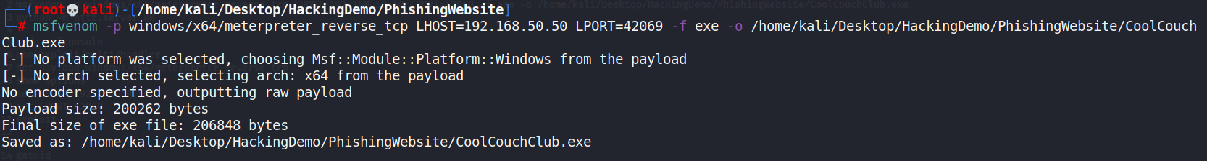
Payload
Kali public IP and listening port
Payload format
Path

Slide 16


Slide 17

EXPLOITATION & INSTALLATION
The Payload Executed By The Employee Gives Us Full Access
Possible lateral movement from inside computer
Abusing the trust from inside devices

Slide 18
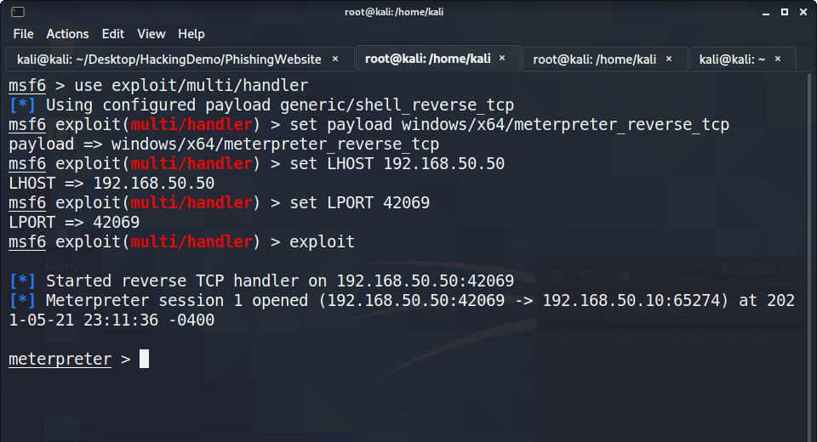
Listening device’s public IP
Listening port
Success
Router public IP and port

Slide 19

COMMAND & CONTROL
We Have To Setup For Our Action Phase And Get To Know The Network
Setup for action phase
Scan the network
Exfiltrate hashes and password
Find a path

Slide 20
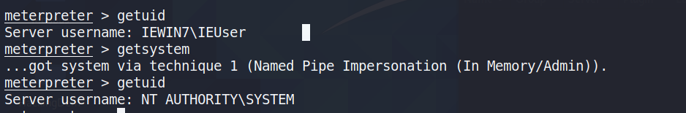
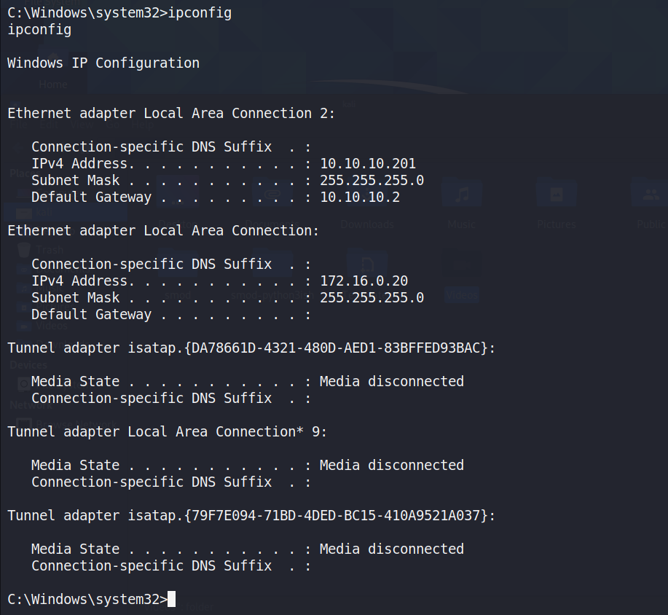
Privilege escalation
IP on network #1
Gateway on network #1
IP on network #2
Network #2 has no gateway

Slide 21
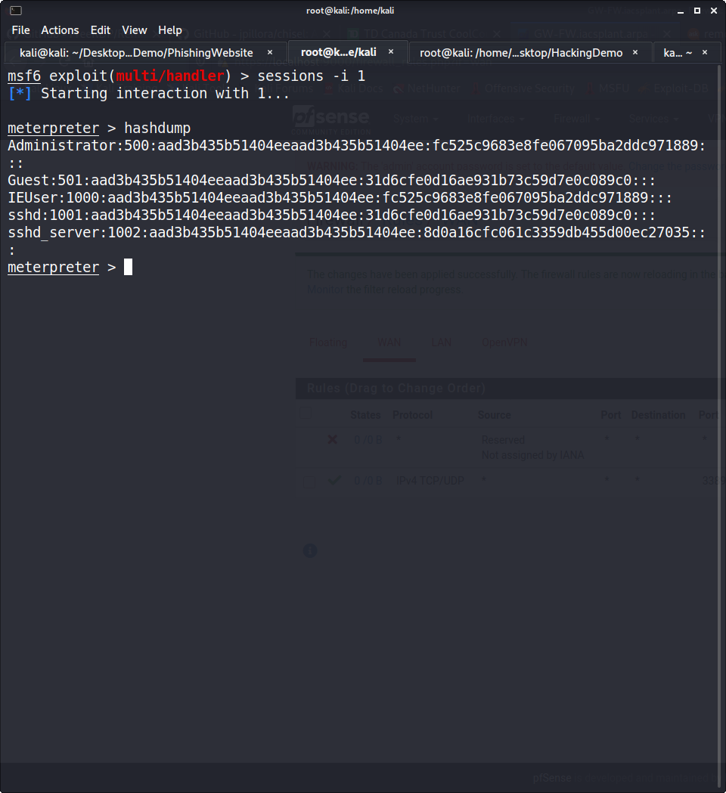
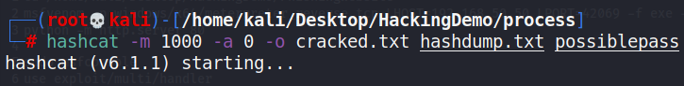
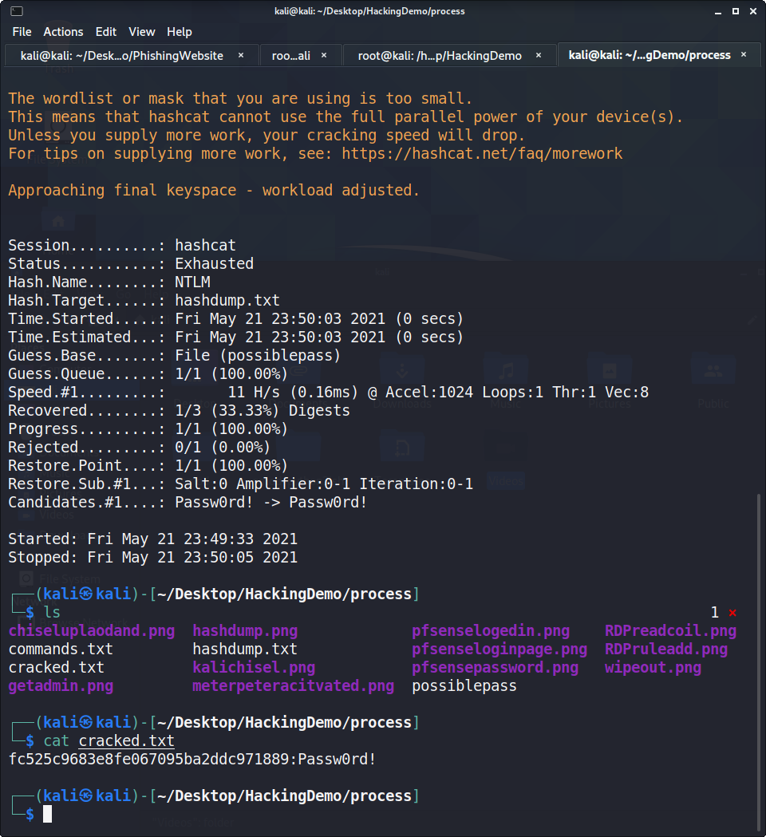
Windows
NTLM
Attack mode: dictionary straight
Save file
Hashes file
Dictionary file
Administrator password

Slide 22
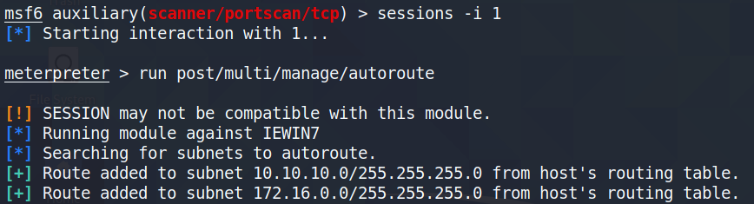
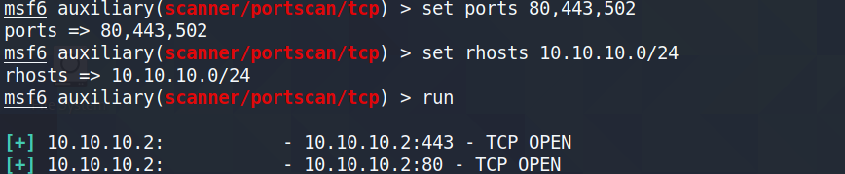
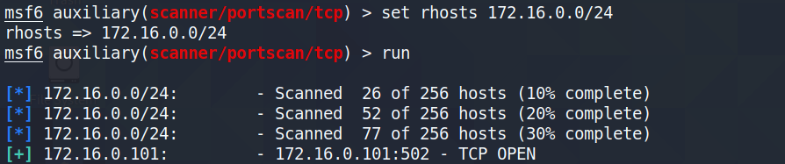
Gateway router/firewall has its HTTP and HTTPS ports open
Modbus devices on the second network

Slide 23
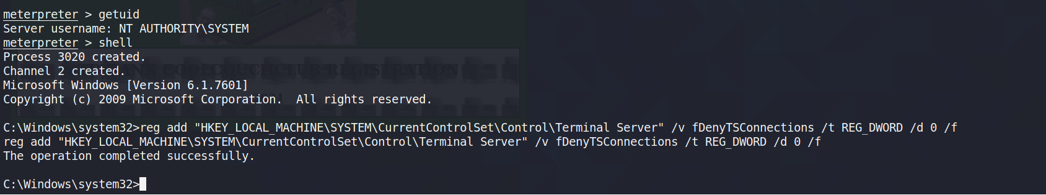
Enabling RDP through modifying windows registries

Slide 24
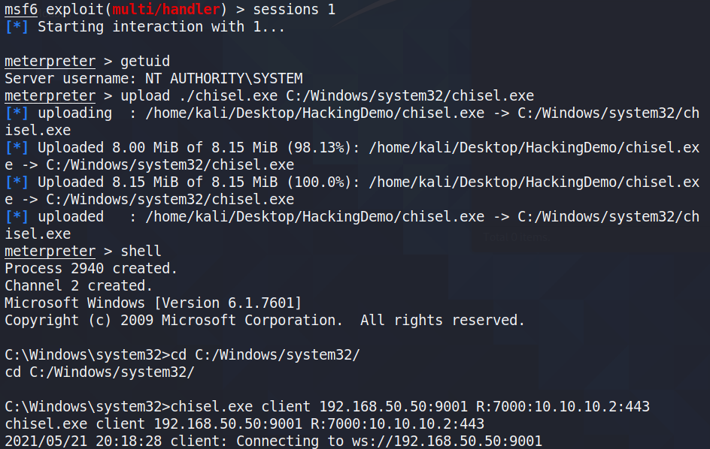
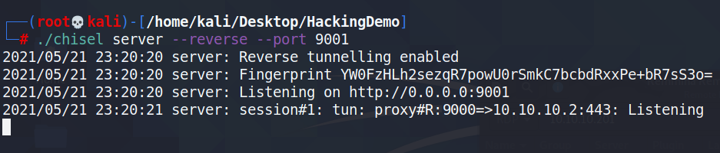
Listening public IP and port
The port on the kali machine we are mirroring the traffic on
The IP and port of what we want to mirror
Mirroring session created

Slide 25
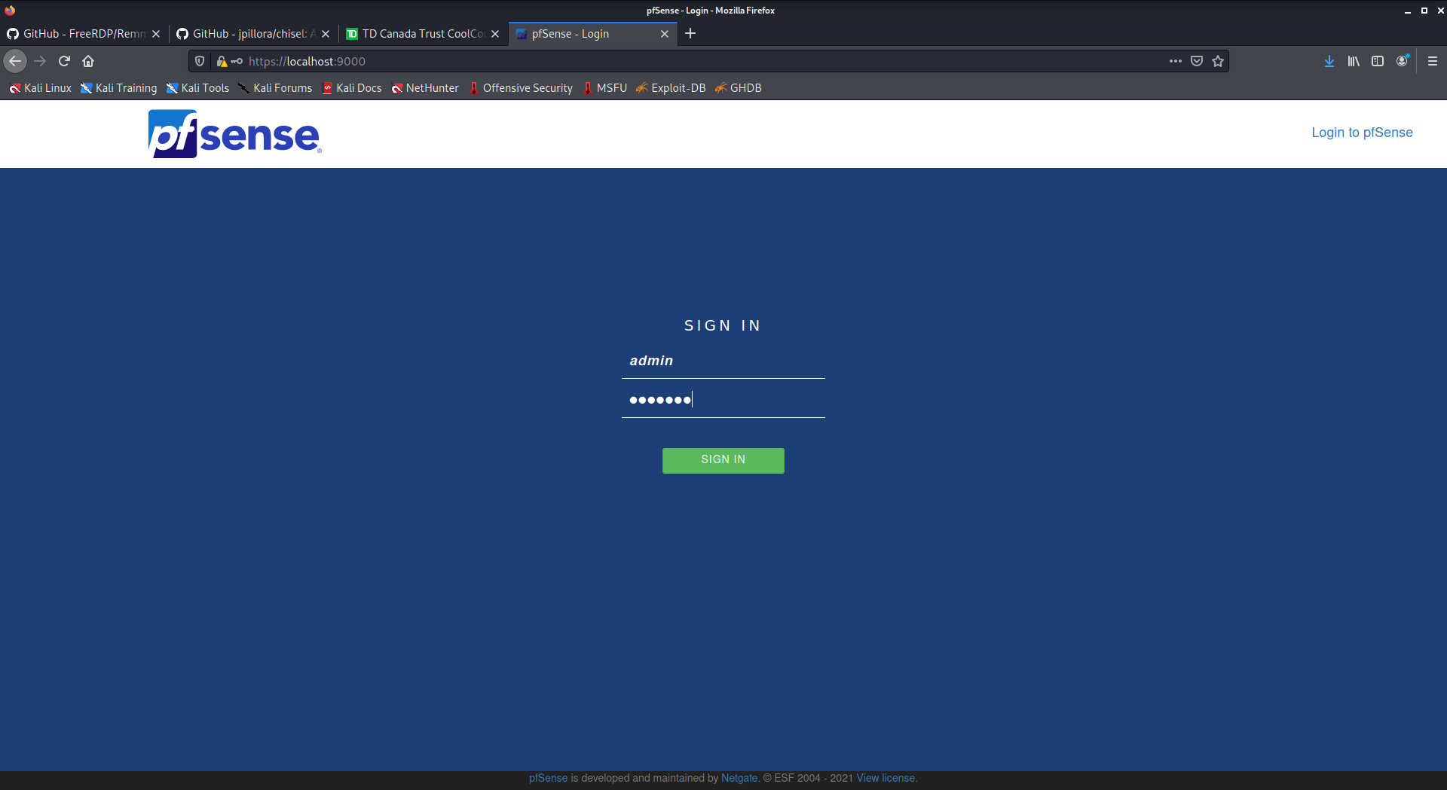
Open the mirrored port on localhost on Kali

Slide 26
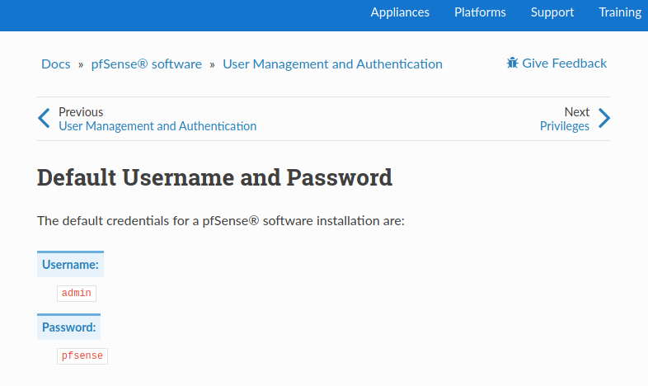

Slide 27
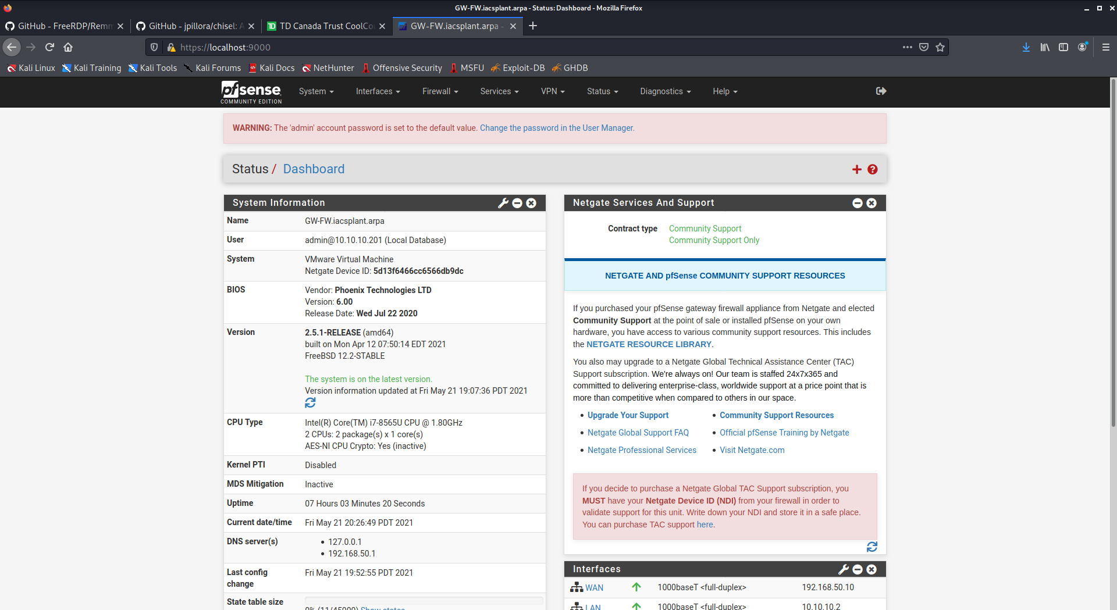
pfSense reminds you to change your default password

Slide 28
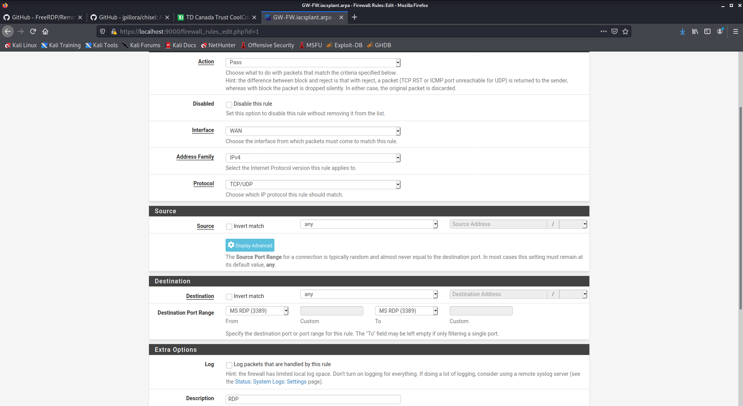

Slide 29
ACTIONS ON OBJECTIVES
With A Clear Path In Mind, Now We Can Achieve Our Objective
With full control over the network and devices inside of it we can do whatever we want
Denial of Service
Physical Disasters
Data Exfiltration
Ransom

Slide 30
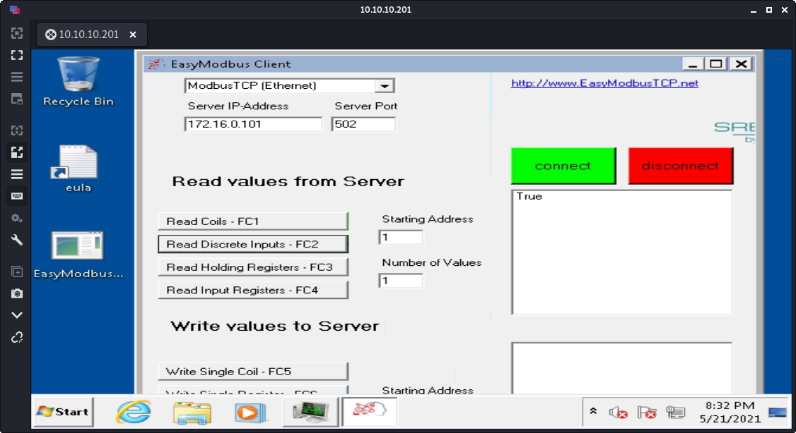

Slide 31
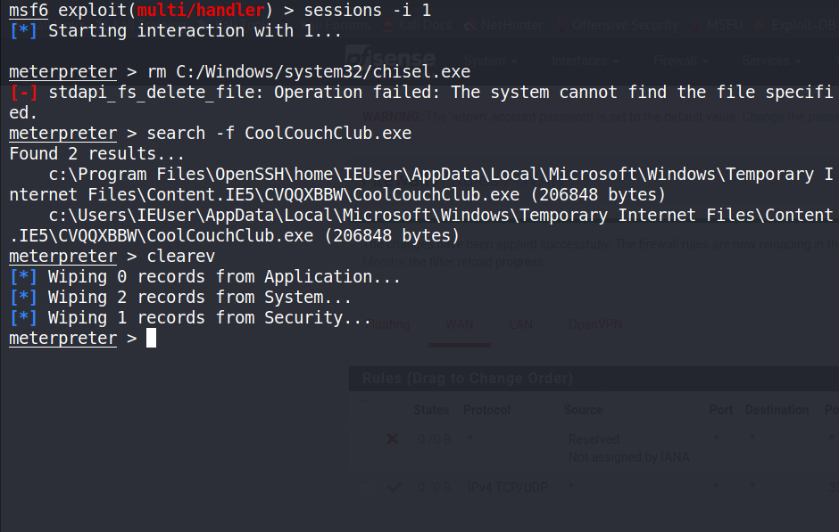
CLEAN UP
Since The Network Doesn’t Have A SIEM And Logging Server, Wiping Out The Victim System Is Enough
Clear memory
Clear used files
Clear logging data
Clear application data

Slide 32

RISK ASSESSMENT
ISA/IEC 62443 Based
Identify Assets
Create Zones and Conduits
Understand Foundational Requirements
Choose Security Levels
Apply Design Principles
(Refer to Extensive Report)

Slide 33

UPDATING OUR NETWORK DESIGN

Slide 34
COUNTERMEASURES
pfSense Firewall
Domain Controller
Security Onion SIEM
FreeBSD based firewall
Two firewalls
- IDMZ firewall
- Gateway firewall
Windows Server 2019
Account administration
- group policies
- domain user accounts
System management controls
DNS resolver
Kibana - Dashboard
Suricata – detect threats and generate alerts
Wazuh security monitoring as a HIDS
Osquery – request real-time information and reporting from the network system

Slide 35
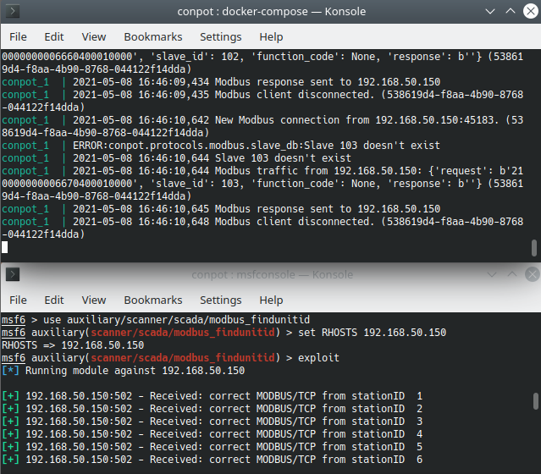
COUNTERMEASURES
Exploit
Honeypot - Conpot
ICS/SCADA honeypot
Light weight honeypot using Python script
Installation and Configuration
- Kubuntu
- Custom Start Script
Conpot

Slide 36
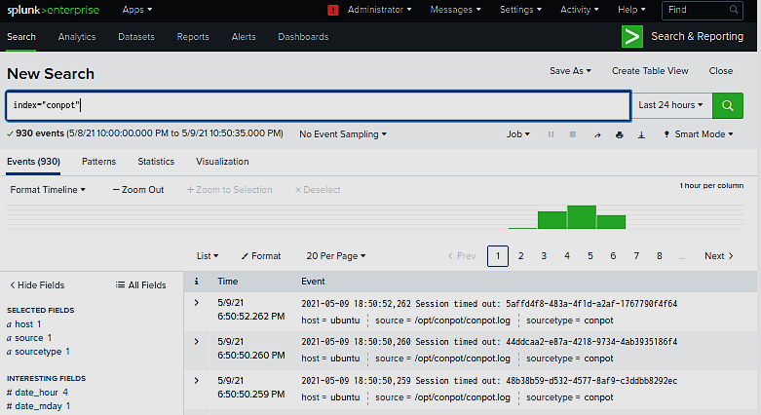
COUNTERMEASURES
Splunk SIEM
Software platform to search, analyze and visualize the machine-generated data gathered from the devices
Sorts out the logs using indexes
Generates alerts

Slide 37
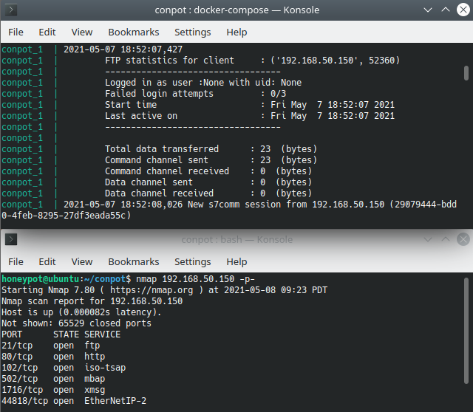
COUNTERMEASURES
Conpot – Splunk Simulation

Slide 38
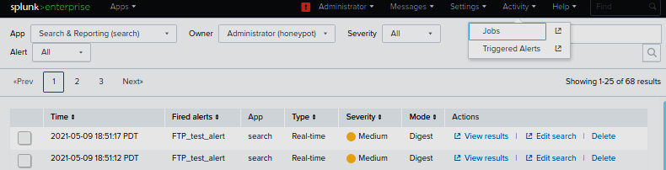
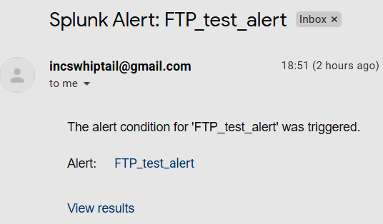
COUNTERMEASURES
Conpot – Splunk Simulation

Slide 39
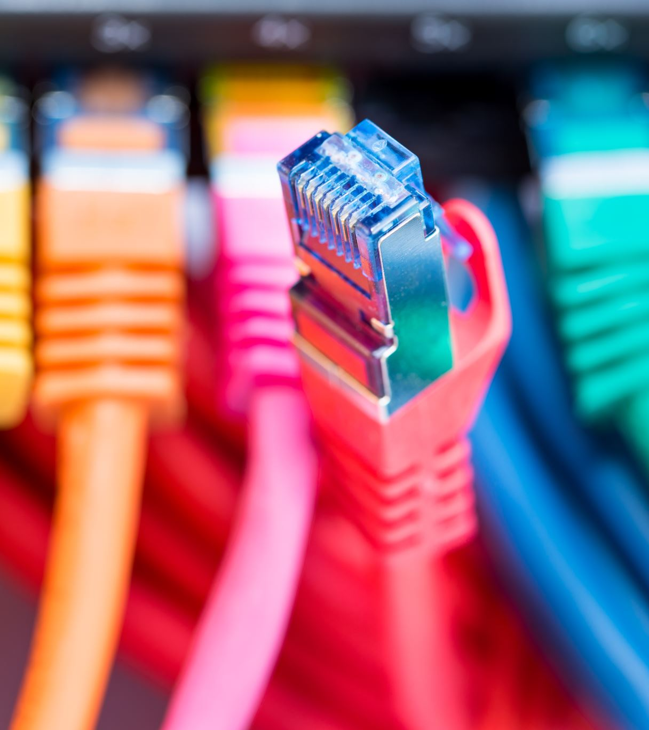
IMPROVED NETWORK DESIGN
Upgrades
Builds on the Original
Learns from the Assessment
Increases Network Visibility

Slide 40
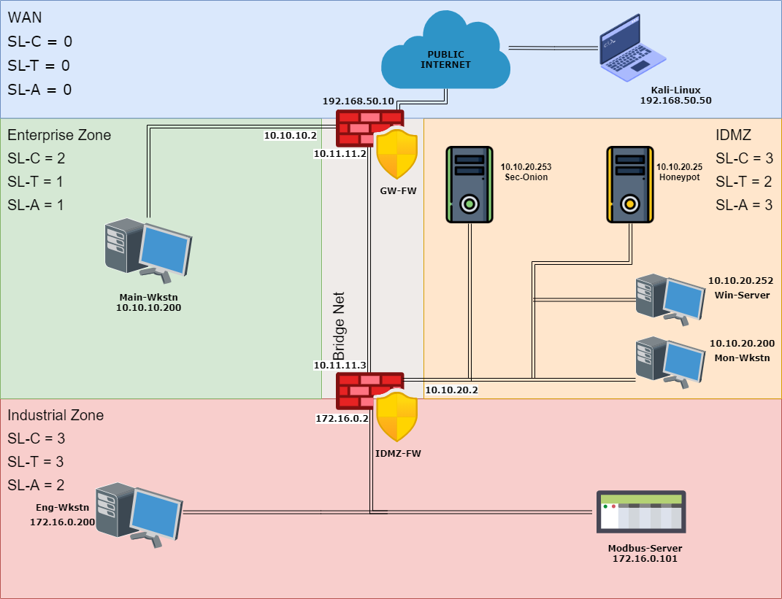
IMPROVED NETWORK DESIGN
Separating Equipment
Adding Zones
Increasing Segmentation
Limiting Traffic Paths
Defense in Depth
5 Areas

Slide 41


IMPROVED NETWORK DESIGN
Firewalls
Stateful Firewall Operation
Traffic is filtered on port of ingress
Connection tables verify return traffic
Certain Traffic Permitted on Specific Ports
(And in specific directions)
Rules…
Enterprise Zone may not reach Industrial Zone
Enterprise and Industrial Zones may Connect to IDMZ
IDMZ may not Initiate Industrial Zone Connections
Industrial Zone has no WAN Access
…and more

Slide 42
IMPROVED NETWORK DESIGN
Domain Controller
Windows Server 2019
Domain Server Role
Enables Domain User Accounts / Groups
Group Policy Affects all Domain Joined Systems
DNS Server Role
All DNS Requests in the Network are Visible
(Domain Name System)

Slide 43
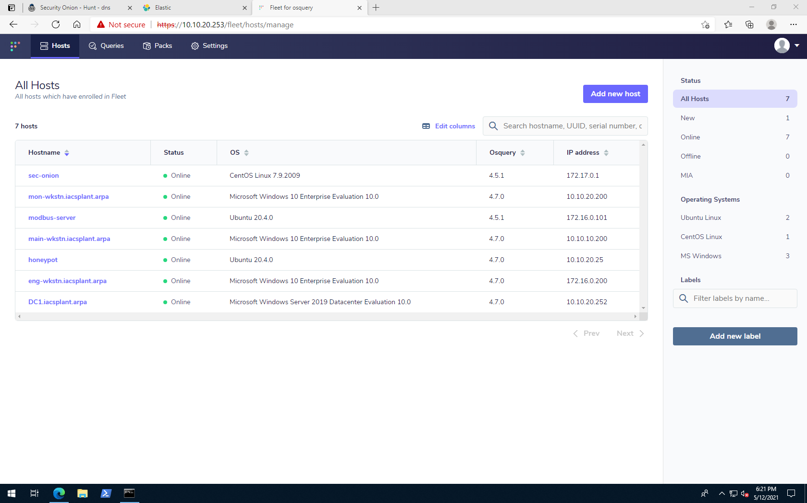
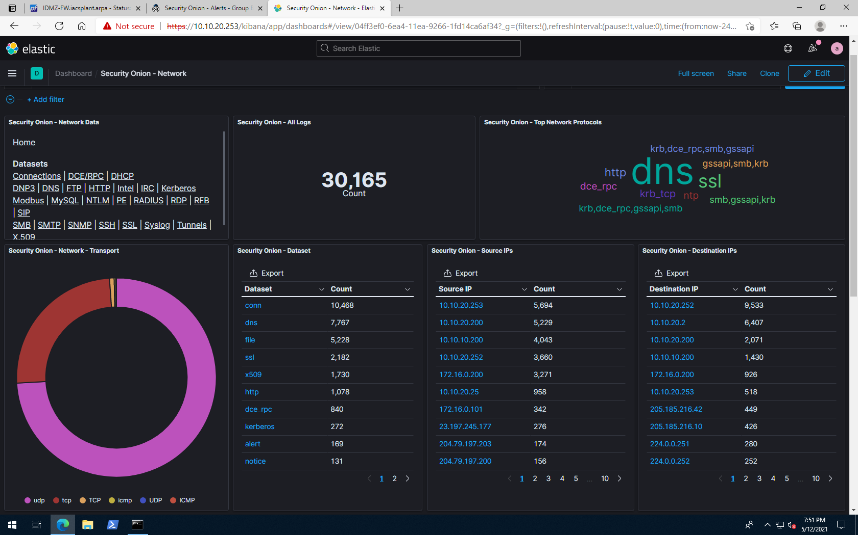
IMPROVED NETWORK DESIGN
Osquery ‘Fleet’ Devices
Security Onion
Kibana Network Dashboard
Threat Hunting
Network Monitoring
Log Management
Wazuh Agents
HIDS for Windows, macOS, Linux OSes
Event and Security Logs sent back to Security Onion
Osquery
Custom SQL-like Queries of Client Machines
Request Real-Time Information from ‘Fleet’ Systems

Slide 44

IMPROVED NETWORK DESIGN
Honeypot
Conpot IACS Honeypot
Looks Valuable
Provides Security Team with Attacker Information
Alerting Mechanism when Coupled with Splunk

Slide 45
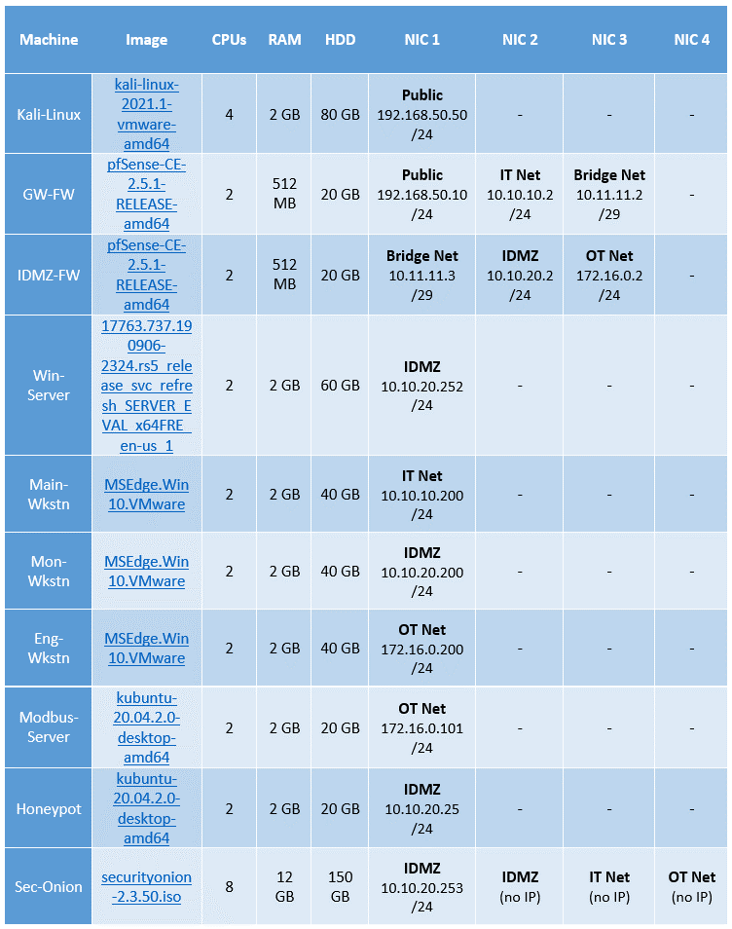
IMPROVED NETWORK DESIGN
Installing Machines
Host Requirements
8 CPU Cores
27 GB RAM (plus overhead)
~200 GB Storage (table shows maximums)

Slide 46
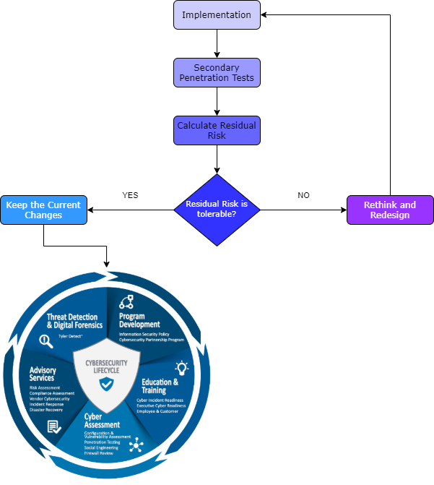
FINAL RISK ASSESSMENT
Reassessment
Security is not a Destination
Continual Improvement is Necessary
Workflow
Implement Design
Test Network
Assess Risks
Decide if Risk is Tolerable or Not
Design Countermeasures
Repeat

Slide 47
SUMMARY
Build initial network system
Perform penetration test
Perform risk assessment
Apply countermeasures
Upgrade network system

Slide 48

QUESTIONS

Slide 49

THANK YOU!
Michael Klym Gary Khodayari Mink Jo

